Slide 1



Kapasa Makasa University
TOOLS FOR LAND USE MAPPING
Lecturer: Mr.B.Mutale

Slide 2
INTRODUCTION
Setting the stage: Why do we need specialized tools for mapping the Earth's surface?

Slide 3




WHY MAPPING MATTERS
Food Security
Urban Planning
Monitoring agricultural land use to predict crop yields and manage irrigation in Zambia’s Muchinga province.
Tracking rapid urban expansion in Chinsali and Lusaka to provide sustainable infrastructure and services.

Slide 4

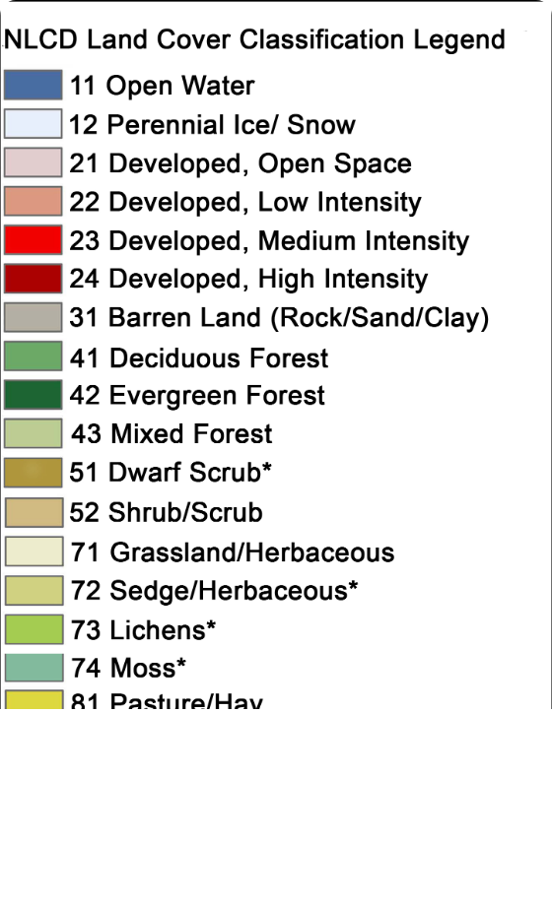
LAND USE VS. LAND COVER
Understanding the Difference
Land Cover: The physical material at the surface (e.g., forest, water, soil).
Land Use: The human activity or economic function of that land (e.g., recreation, grazing, residential).

Slide 5
THE MAPPING WORKFLOW
Planning
Acquisition
Processing
Validation
Dissemination
Defining scope & tools
Sensing & GPS
GIS Analysis
Field verification
Maps & Reports

Slide 6






MAIN TOOL CATEGORIES
Remote Sensing
Field Survey
Software/GIS
Satellites, Aircraft, Drones
GPS/GNSS, Mobile Apps
Analysis & Storage

Slide 7
REMOTE SENSING
Eyes in the sky: Data from a distance.

Slide 8

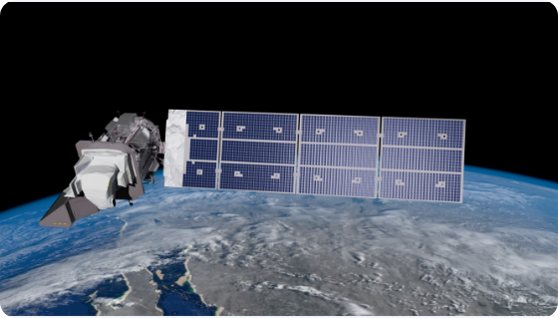
NASA/USGS LANDSAT
The Gold Standard
•
50+ years of continuous Earth records.
•
Resolution: 30 meters (Perfect for regional mapping).
•
Availability: Completely Free.
•
Essential for tracking deforestation trends in Zambia since the 1970s.

Slide 9
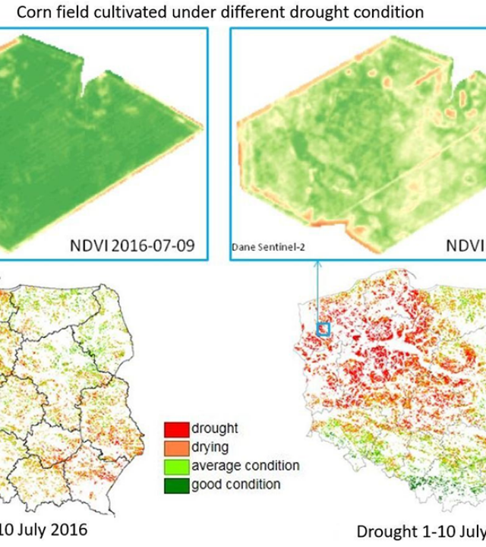
ESA SENTINEL-2
High-Frequency Monitoring
Provides 10-meter resolution images every 5 days globally.
13 spectral bands allow for sophisticated vegetation analysis (NDVI) and agricultural health monitoring.

Slide 10
VERY HIGH RESOLUTION (VHR)
PlanetScope: Daily imagery of the whole world at 3m resolution.
WorldView: Sub-meter resolution (30-50cm) for identifying individual buildings or trees.
Maxar/DigitalGlobe: Industry leaders in commercial high-res tasks.
Application: Critical for urban cadastral mapping and security monitoring.

Slide 11



RADAR MAPPING (SAR)
Cloud Penetration
Day/Night Capability
Synthetic Aperture Radar (SAR) like Sentinel-1 uses microwave pulses that pass through clouds, smoke, and rain.
Active sensors provide their own light source, allowing mapping during the night—crucial for flood monitoring during Zambia's rainy season.

Slide 12

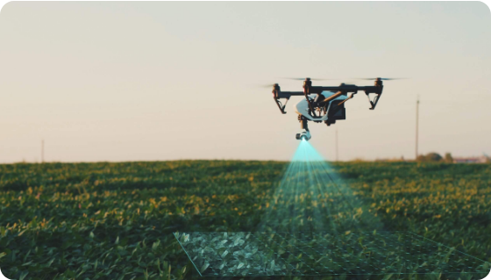
UNMANNED AERIAL VEHICLES
Precision on Demand
Drones (UAVs) provide centimeter-level resolution (GSD) for small project areas.
Use Case: Creating high-fidelity maps for Chinsali municipal planning or individual farm plot monitoring.

Slide 13
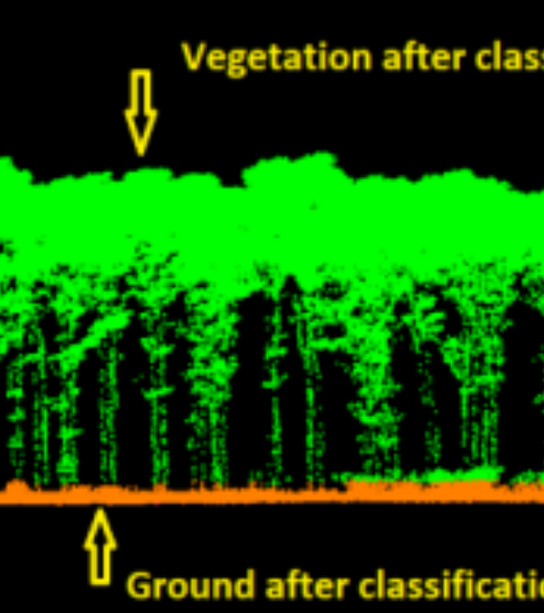
LIDAR TECHNOLOGY
3D Structure Mapping
Uses laser pulses to measure distance.
Can "see through" tree canopies to map the terrain (Digital Terrain Model) and measure forest biomass with incredible accuracy.

Slide 14
FIELD SURVEY & GNSS
Ground-truthing and absolute positioning.

Slide 15


GNSS BASICS
Beyond "GPS"
Positional Accuracy
Global Navigation Satellite Systems (GNSS) include:
The accuracy depends on the number of satellites in view and the receiver quality. Essential for fixing land boundaries.
•
GPS (USA)
•
GLONASS (Russia)
•
Galileo (Europe)
•
BeiDou (China)

Slide 16

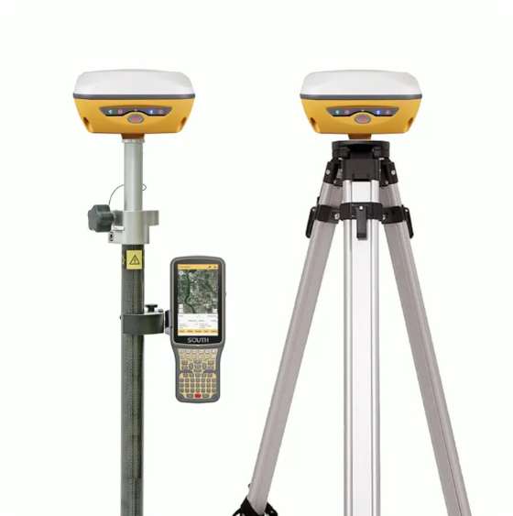
SURVEY-GRADE HARDWARE
Differential & RTK
Real-Time Kinematic (RTK) GPS provides 1-3cm accuracy by using a base station and a rover.
Professional brands like Trimble, Leica, and Topcon are common in Zambian civil engineering and survey firms.

Slide 17




MOBILE DATA COLLECTION
KoboToolbox
ArcGIS Field Maps
Avenza Maps
Free, open-source tool for field data collection on Android devices. Used for social surveys and ground-truthing.
Mobile app for field workers to view and update GIS maps in real-time synced with the office.
Allows use of geo-referenced PDF maps offline. Great for forest patrol and remote areas.

Slide 18
GIS & ANALYSIS TOOLS
Turning raw data into intelligence.

Slide 19

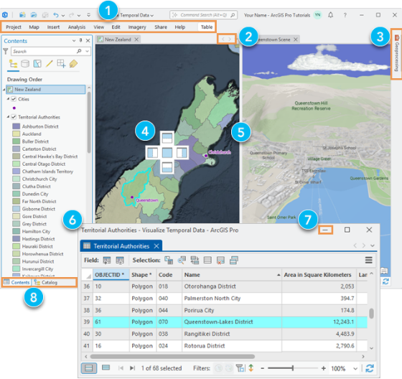
DESKTOP GIS: ARCGIS PRO
Industry Standard
Powerful spatial analysis tools.
Extensive documentation and support.
Cloud integration (ArcGIS Online).

Slide 20

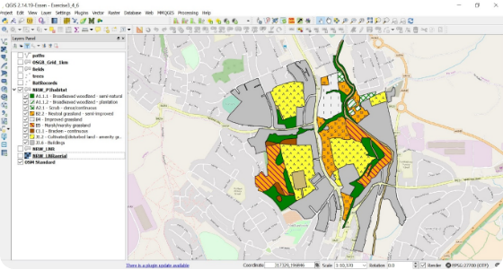
DESKTOP GIS: QGIS
Open Source Champion
Completely free and open-source. Used extensively in KMU student projects.
Supports almost every spatial data format and offers thousands of user-developed plugins.

Slide 21

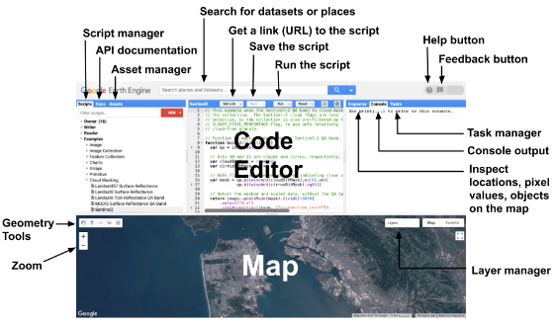
CLOUD GIS: GOOGLE EARTH ENGINE
Big Data Processing
A cloud-based platform for multi-petabyte geospatial analysis.
Students can use JavaScript or Python to analyze 40 years of satellite data for the whole of Zambia in seconds.

Slide 22
AI & AUTOMATION
Machine Learning in Land Use Classification.

Slide 23

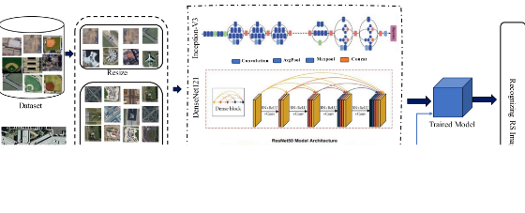
IMAGE CLASSIFICATION TOOLS
Automating Maps
Instead of manual tracing, we use algorithms to recognize land use types.
Supervised Learning: You teach the computer by providing "training samples" of known land types.

Slide 24
OBJECT-BASED ANALYSIS (OBIA)
Segments, Not Pixels
High-Res Necessity
OBIA groups pixels into meaningful objects based on shape, texture, and relationship to neighbors.
Critical for analyzing drone and VHR satellite imagery where pixel-based methods often fail (the "salt and pepper" effect).

Slide 25






ONLINE DATA REPOSITORIES
ESA WorldCover
Global Forest Watch
NASA Earthdata
Global 10m land cover product based on Sentinel-1 and 2 data.
Real-time alerts and data on forest loss and gain.
One-stop shop for all NASA satellite datasets.

Slide 26
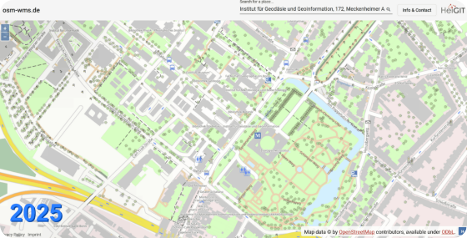

OPENSTREETMAP (OSM)
Crowdsourced Mapping
The "Wikipedia of Maps." Volunteers globally map roads, buildings, and land use.
Importance: Most mapping in Chinsali is updated by OSM contributors, providing a vital base layer for planners.

Slide 27
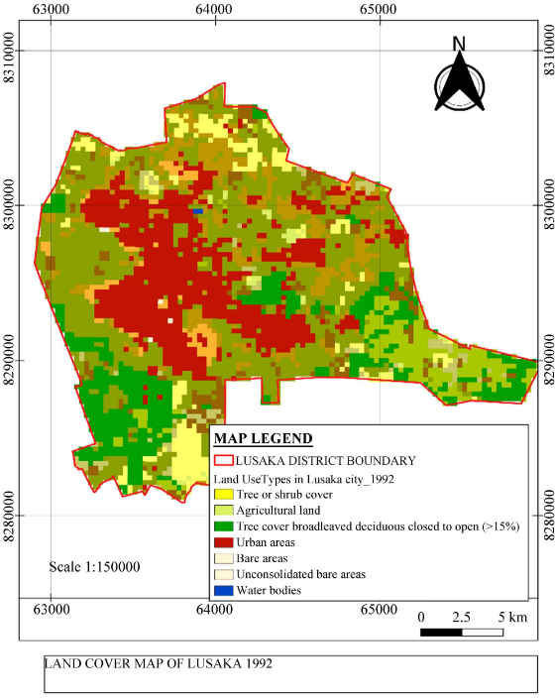

THE ZAMBIAN CONTEXT
Local Institutional Tools
•
ZMA: Zambia Ministry of Agriculture portals.
•
Zambia Statistics Agency: Demographic spatial data.
•
Deforestation tracking: Tools used by the Forestry Department and MLNR.

Slide 28
FUTURE TRENDS IN MAPPING
Hyperspectral Imaging: Hundreds of bands for detecting soil minerals or specific plant diseases.
Real-time Streaming: Satellite video and live-updating maps.
Edge Computing: Drones processing classification data onboard in real-time.
Participatory GIS: Local communities using apps to map their own indigenous land use.

Slide 29
ETHICS & CONSIDERATIONS
Mapping Bias
Data Privacy
Who is being mapped? Who is doing the mapping? We must ensure mapping reflects local reality, not just external priorities.
With high-res imagery, individuals' privacy can be compromised. Regulations are evolving to manage these risks.

Slide 30

QUESTIONS & DISCUSSION
Thank you for your attention.

